Slide 1
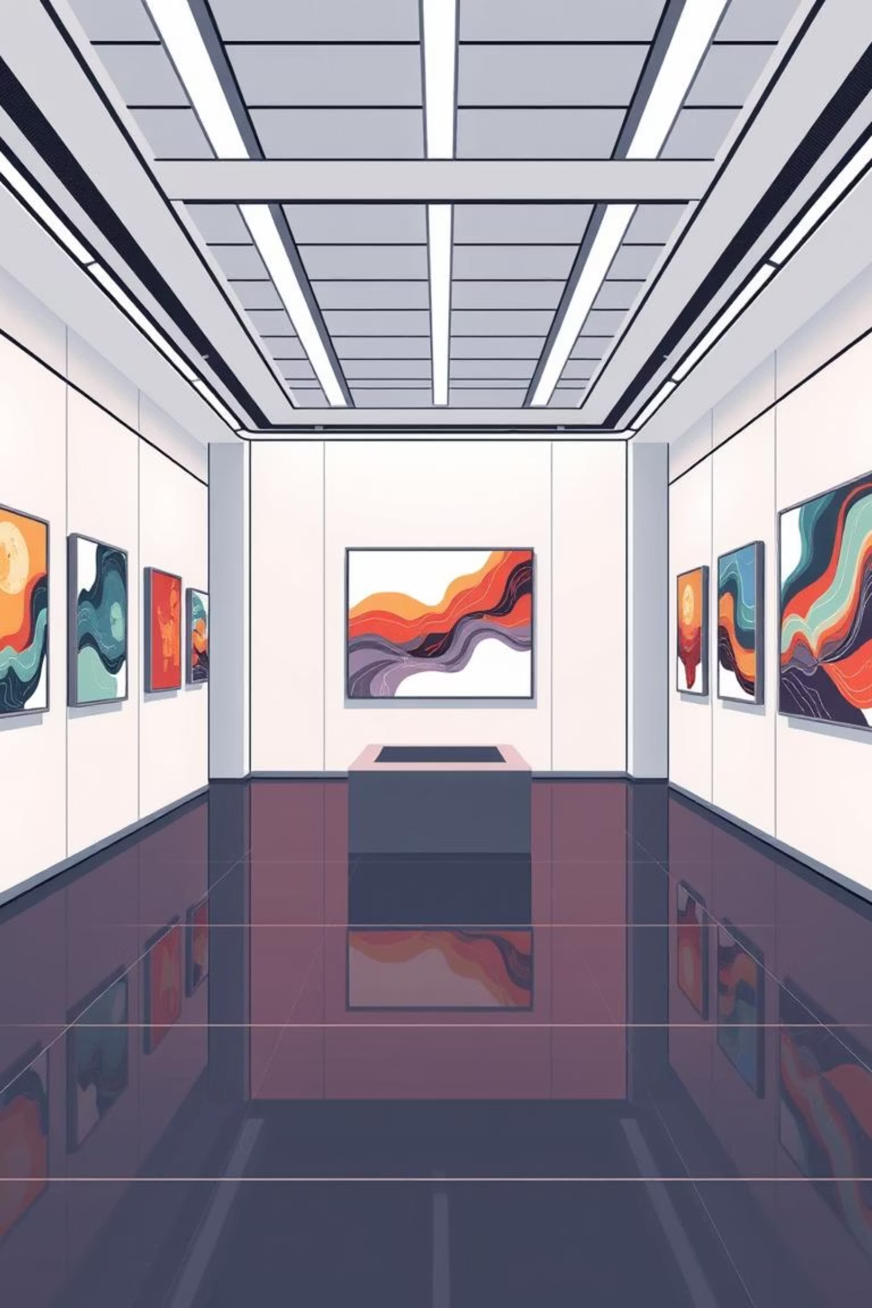
Online Art Gallery with Artist Portfolios
A DBMS Project Presentation

Slide 2
Our Project Team
Hossain Ibn Masudul Haque
Samia Zahan Disha
ID: 232-15-260
ID: 232-15-919
Md. Sadman Hafij
Shakib Bhuiyan
ID: 232-15-119
ID: 232-15-460
Tommy Saha Chowdhury
Jogonnath Dey
ID: 232-15-022
ID: 232-15-514

Slide 3
Introduction: Bridging Art & Technology
Project Purpose
Why Online Art Matters
To develop a robust Database Management System for an online art gallery, facilitating seamless interaction between artists and art enthusiasts.
In an increasingly digital world, accessibility to art is crucial. Our platform removes geographical barriers, making art discoverable by a global audience.
Core Features
Comprehensive Artist Profilos
Virtual Exhibitions & Galleries
Online Auctions & Sales Management
Secure Transaction Tracking

Slide 4
Motivation: Addressing Key Challenges
Challenges for Artists
Limited visibility beyond local networks.
Prohibitive costs associated with physical exhibitions.
Difficulty reaching diverse collectors.
Challenges for Art Lovers
Geographical limitations to viewing diverse art.
Time constraints for visiting physical galleries.
Missed opportunities for discovering new talent.
Our goal: to bridge the gap, connecting artists and audiences worldwide, fostering a vibrant global art community.

Slide 5
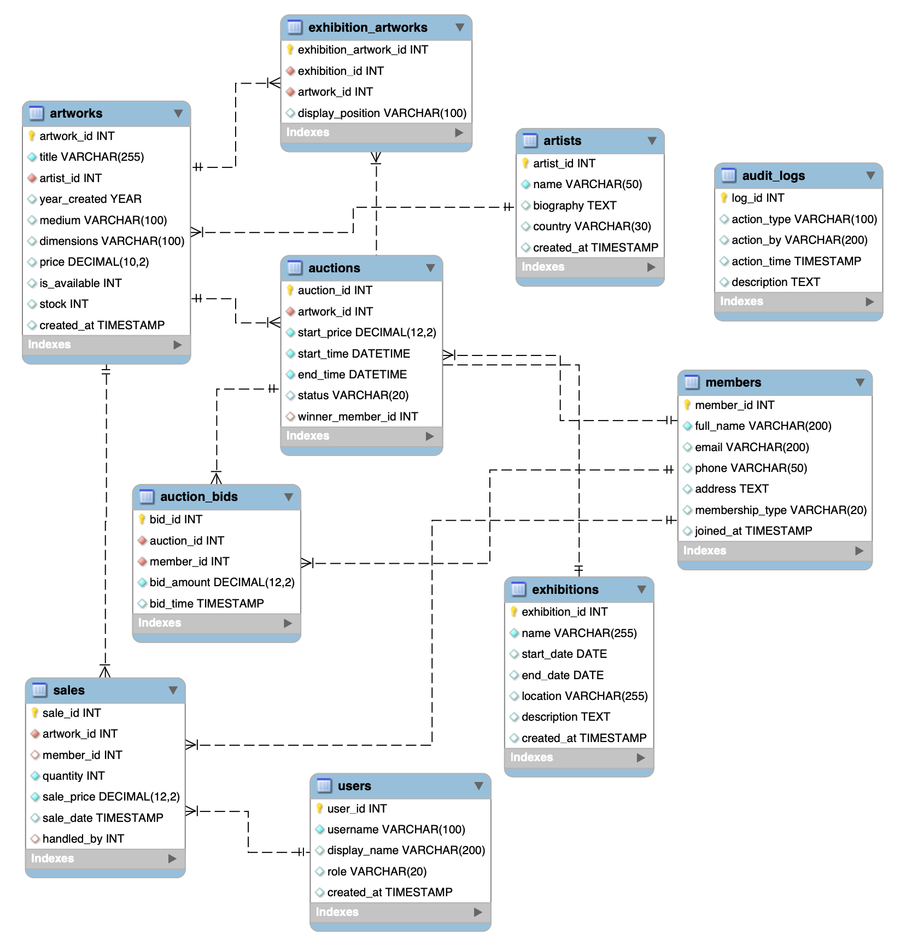
ER DIAGRAM
Our goal: to bridge the gap, connecting artists and audiences worldwide, fostering a vibrant global art community.

Slide 6
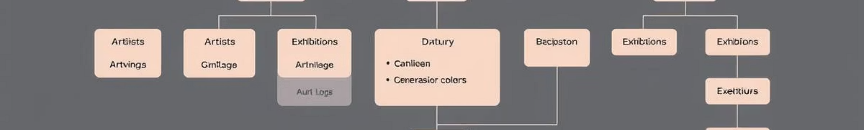
Relational Schema: System Architecture
Our robust database design underpins all gallery functionalities, ensuring efficient data management and retrieval.
Key Entities & Relationships:
Artists: Creator details, portfolios.
Artworks: Metadata, images, status.
Members: User profiles, purchasing history.
Sales: Transaction records, pricing.
Exhibitions: Curated collections, themes.
Auctions: Bid history, winning bids.
Bids: Member-specific bids on artworks.
Audit Logs: System activity and changes.

Slide 7

Gap Analysis: Improving the Art Landscape
Existing Issues
Our Project's Solutions
Fragmented online presence.
All-in-one comprehensive platform.
High commission fees for artists.
Affordable entry for artists.
Lack of regional support infrastructure.
Mobile-friendly access for users.
Complex, outdated admin tools.
Simplified, intuitive admin interface.
We aim to create a more inclusive and accessible art market by directly addressing the shortcomings of current solutions.

Slide 8




Impacts & Benefits: A Holistic Approach
Impact on Life
Societal & Environmental
Artists gain global visibility.
Reduced carbon footprint (less travel).
Collectors access diverse art 24/7.
Paperless art exhibition management.
Eco-conscious operations.
Ethical Considerations
Sustainability
Robust data privacy measures.
Scalable database architecture.
Strict security protocols.
Cloud hosting for resilience.
Ensuring artist rights & fair use.
Options for renewable energy powered servers.

Slide 9

Project Limitations: Current Scope
While our DBMS project provides a strong foundation, certain features fall outside its current scope for this phase.
Key Limitations:
Backend Focus: This project concentrates solely on the database and its functionality, without a complete front-end user interface.
No Real-Time Notifications: Instant alerts for bids, sales, or new artworks are not yet implemented.
Payment & Shipping: Direct integration with payment gateways or shipping logistics is beyond this initial scope.
Storage & Security: Advanced image storage solutions and cutting-edge security features require future development.
These areas represent clear pathways for future development to evolve the platform into a fully functional online gallery.

Slide 10

Future Work: Expanding Capabilities
Our project lays the groundwork for a comprehensive online art gallery. Future iterations will focus on enhancing user experience and platform functionality.
Full Web & Mobile Application
Develop intuitive interfaces for both desktop browsers and mobile devices.
Secure Payment Gateways
Integrate robust systems for secure transactions and multi-currency support.
Real-Time Notifications
Implement instant alerts for critical events like new bids, sales, or messages.
Enhanced Search & Filtering
Develop advanced algorithms for precise artwork discovery by genre, style, artist, and more.
Cloud Hosting & Disaster Recovery
Migrate to a scalable cloud environment with robust backup and recovery protocols.

Slide 11

Conclusion & Q&A
Our DBMS project provides a solid, database-driven foundation for a dynamic online art gallery. It streamlines the management of artists, artworks, sales, and auctions, ready for seamless integration into web and mobile applications.
Ultimately, our system is designed to bring art and audiences closer together, fostering a more connected and accessible global art community through technology.
Thank You. Questions?

